Slide 1

TRENDS AND DYNAMICS

Slide 2

Introduction
Head and Shoulder Patterns
Double Peak Pattern
Double Bottom Pattern
Support and Resistance
Fibonacci Retracement

Slide 3
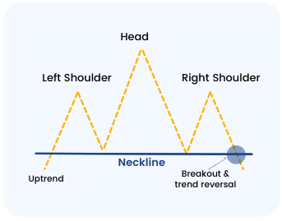
Head and Shoulder Pattern
A baseline with three peaks.
The middle peak being the highest.
A Reversal Pattern.

Slide 4
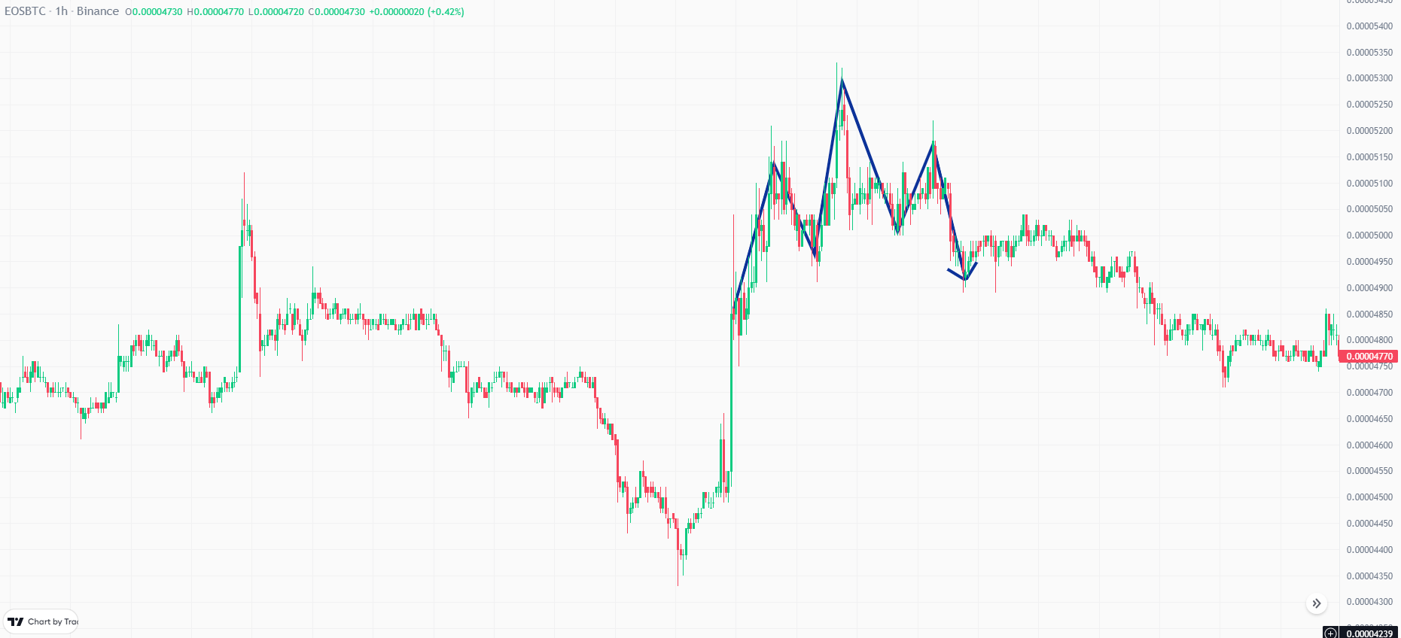
Head and Shoulder Pattern

Slide 5
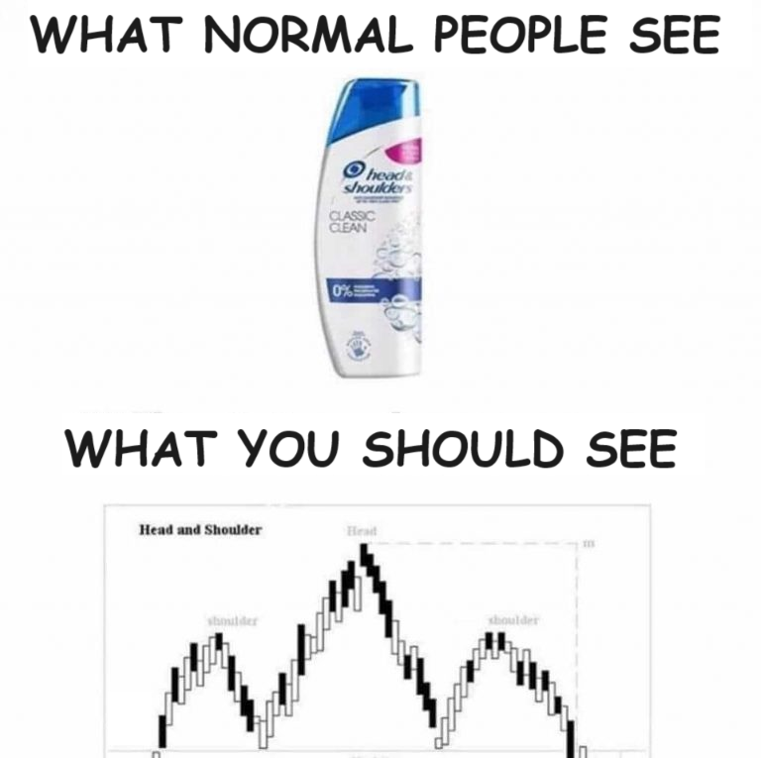
Head and Shoulder Pattern

Slide 6
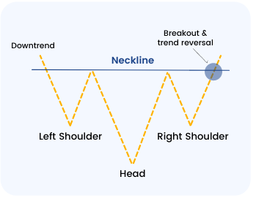
Reverse Head and Shoulder Pattern
Reversal Pattern
Down to up

Slide 7
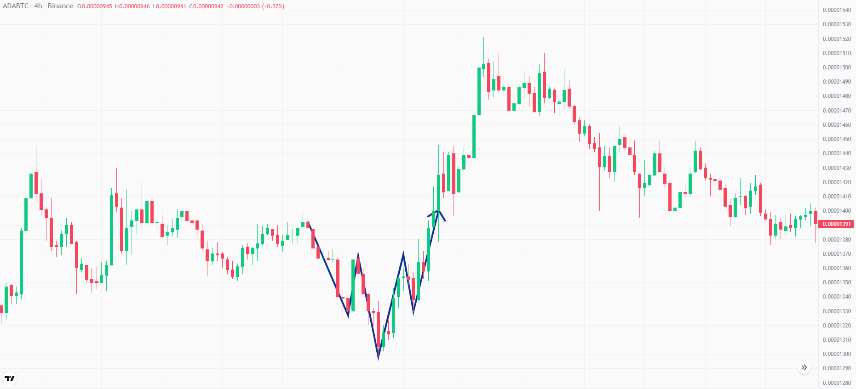
Reverse Head and Shoulder Pattern

Slide 8
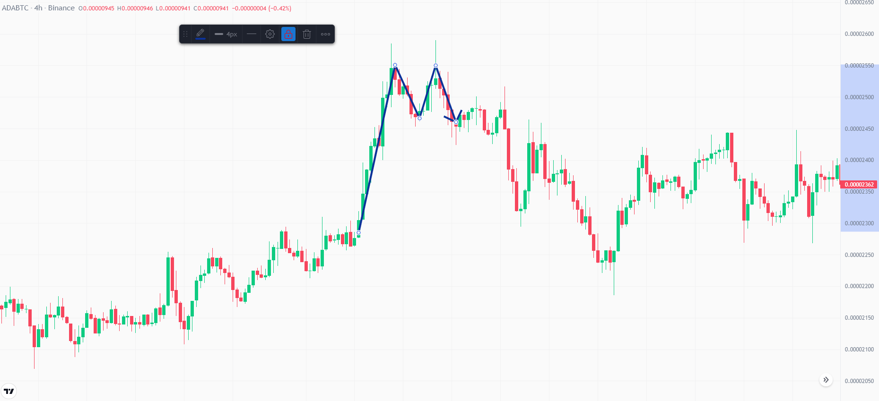
Double Peak Pattern
Reversal Pattern up to down

Slide 9
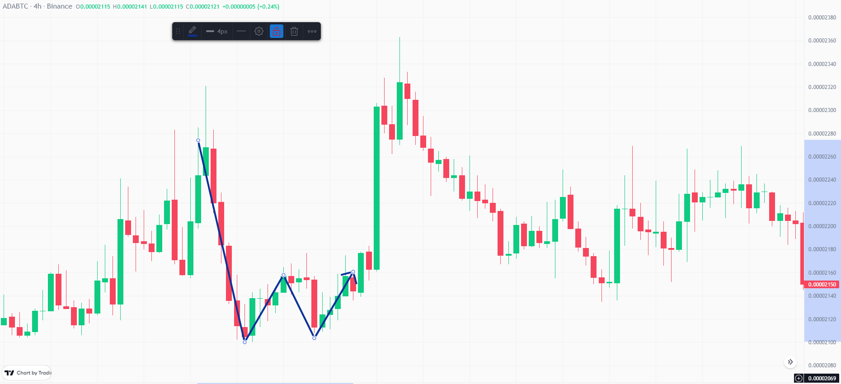
Double Bottom Pattern
Reversal Pattern Down to Up

Slide 10
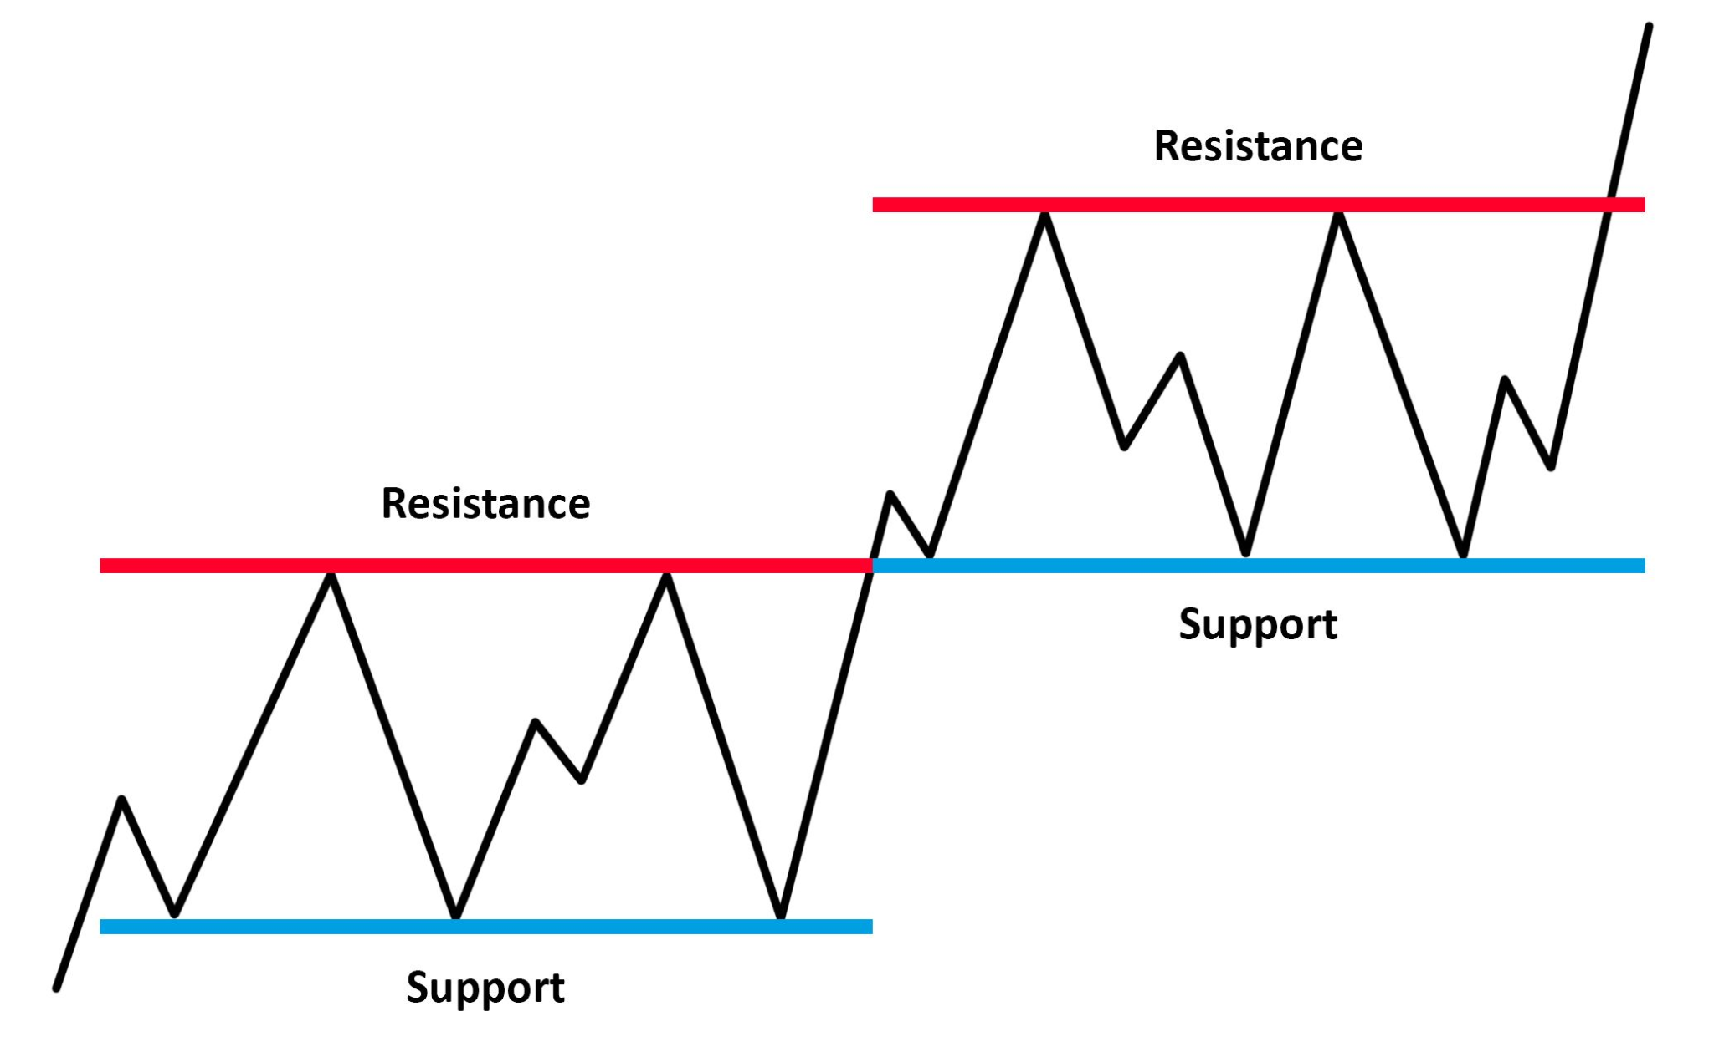
Support and Resistance
Support and Resistance
An evaluation level
Acts as a supporting or resisting barrier for the price of a certain security.

Slide 11
Support and Resistance
Major types:
Long term: Monthly/ Weekly/ Daily
Short term: 4h/1h
On chart types:
Price level support and resistance (Horizontal Support)
Dynamic support and resistance (EMA, MA → Moving Indicators)
Trend line support and resistance (Channels, Trend lines, Triangles)
Whale Support

Slide 12
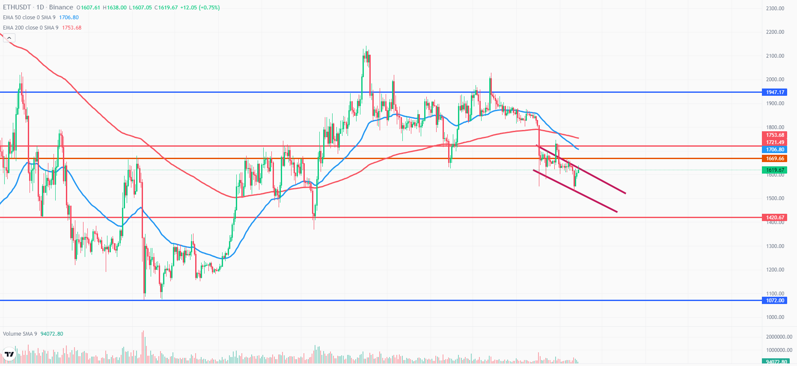
Support and Resistance

Slide 13
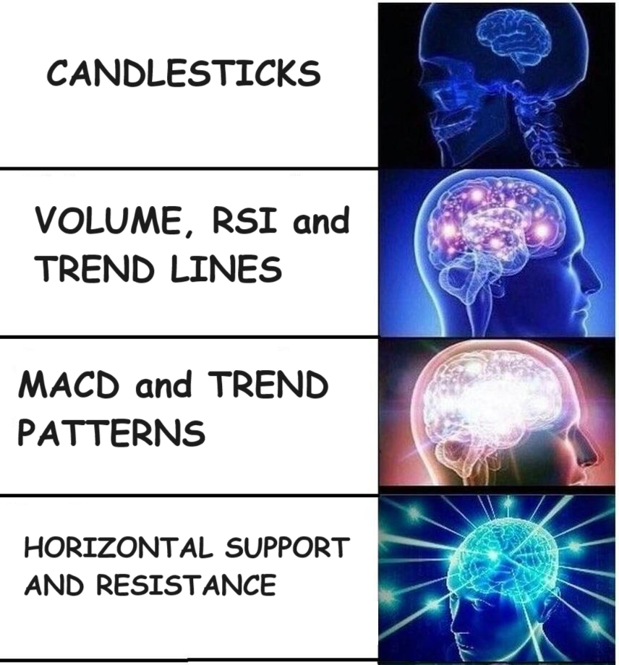
Support and Resistance

Slide 14
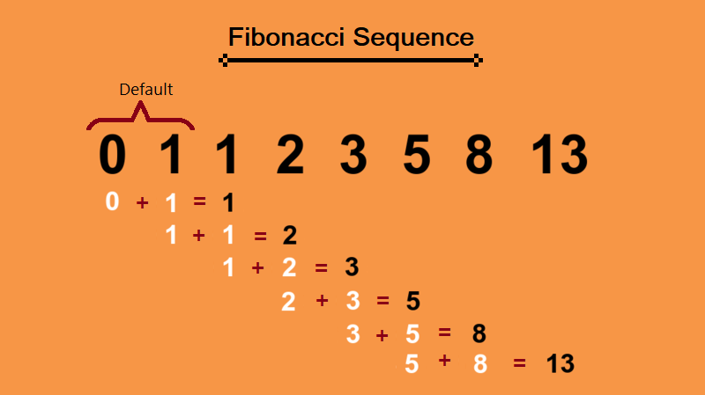
Fibonacci Retracement

Slide 15
Fibonacci Retracement
Introduction:
Italian mathematician Leonardo Fibonacci.
An infinite sequence of numbers.
Appears mysteriously in a variety of scientific and natural contexts.
Natural World:
Phyllotaxis, Reproduction of rabbits, Pinecones and pineapples and DNA etc.
[0, 1, 1, 2, 3, 5, 8, 13, 21, 34]
Notes:
Phyllotaxis: Many plants exhibit the Fibonacci sequence in the arrangement of leaves along the stem, which optimizes exposure to sunlight and rain.
Reproduction of rabbits: This was actually the problem that introduced Fibonacci sequence. Fibonacci posed and solved a problem in the “Book of Calculation” involving the growth of a population of rabbits based on idealized assumptions.
Pinecones and pineapples: The spirals on pinecones and pineapples reflect Fibonacci numbers.
DNA: The Fibonacci sequence also appears in the structure of DNA, with one complete turn of the double helix measuring 34 angstroms in length and 21 angstroms in width (both Fibonacci numbers).
https://tecadmin.net/what-is-fibonacci-sequence/

Slide 16
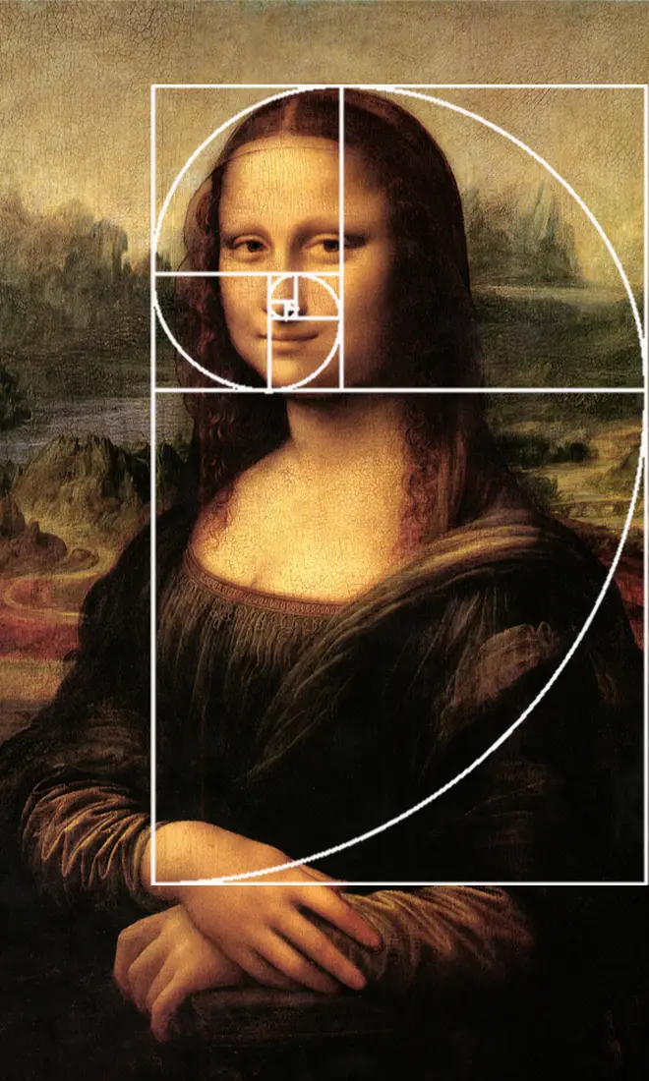
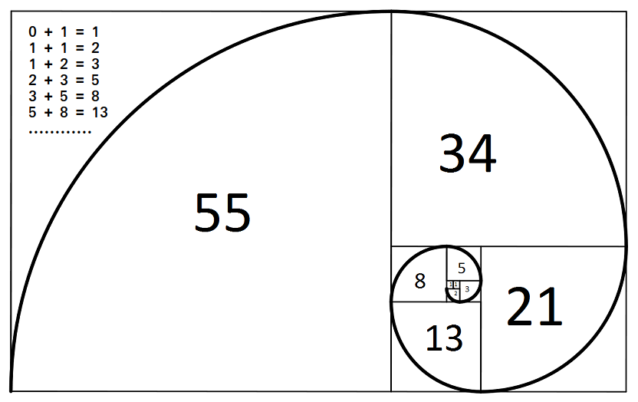
Fibonacci Retracement
Notes:
This sequence, pattern and spiral crop up in many things you might have never noticed. It is used in art and music; just look at how Leonardo da Vinci employed it in one of his most famous paintings, the Mona Lisa:

Slide 17
Fibonacci Sequence | Ratio with next number % | Ratio with number after next % | Ratio with number after two %
0 | - | - | -
1 | 100 | 50.00 | 33.33
1 | 50 | 33.33 | 20.00
2 | 66.67 | 40.00 | 25.00
3 | 60.00 | 37.50 | 23.08
5 | 62.50 | 38.46 | 23.81
8 | 61.54 | 38.10 | 23.53
13 | 61.76 | 38.24 | 23.64
21 | 61.76 | 38.18 | 23.60
34 | 61.82 | 38.20 | 23.61
55 | 61.80 | 38.19 | 23.61
89 | 61.81 | 38.20 | 23.61
144 | 61.80 | 38.20 | 23.61
233 | 61.80 | 38.20 | 23.61
377 | 61.80 | 38.20 | 23.61
610 | 61.80 | 38.20 | 23.61
987 | 61.80 | 38.20 | 23.61
1597 | 61.80 | 38.20 | 23.61
2584 | 61.80 | 38.20 | 23.61
Notes:
https://soccermatics.medium.com/how-we-solved-a-da-vinci-code-mystery-about-the-origin-of-life-5d269640c7d4

Slide 18
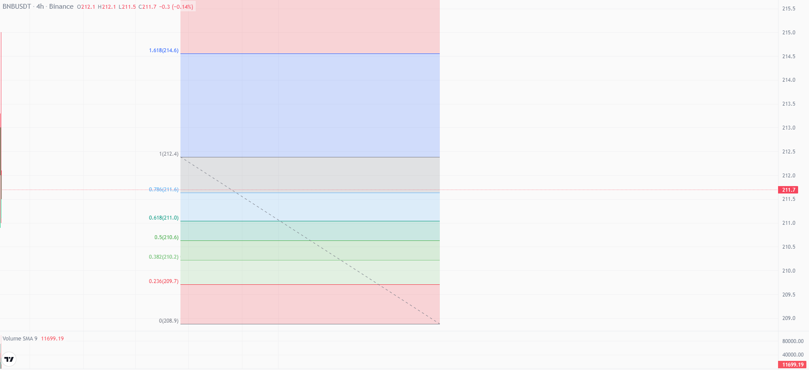
Fibonacci Retracement - Up Trend

Slide 19
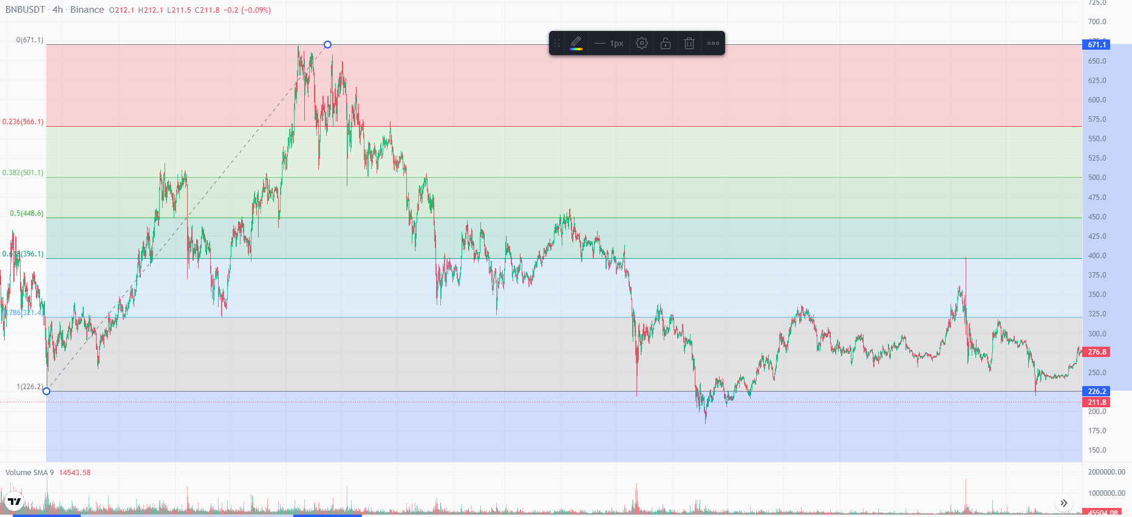
Fibonacci Retracement - Down Trend
Price will always follow a price action format
After an up trend finishes, if I want to predict till where the down trend will go, In that case we’ll use this from bottom to top.

Slide 20
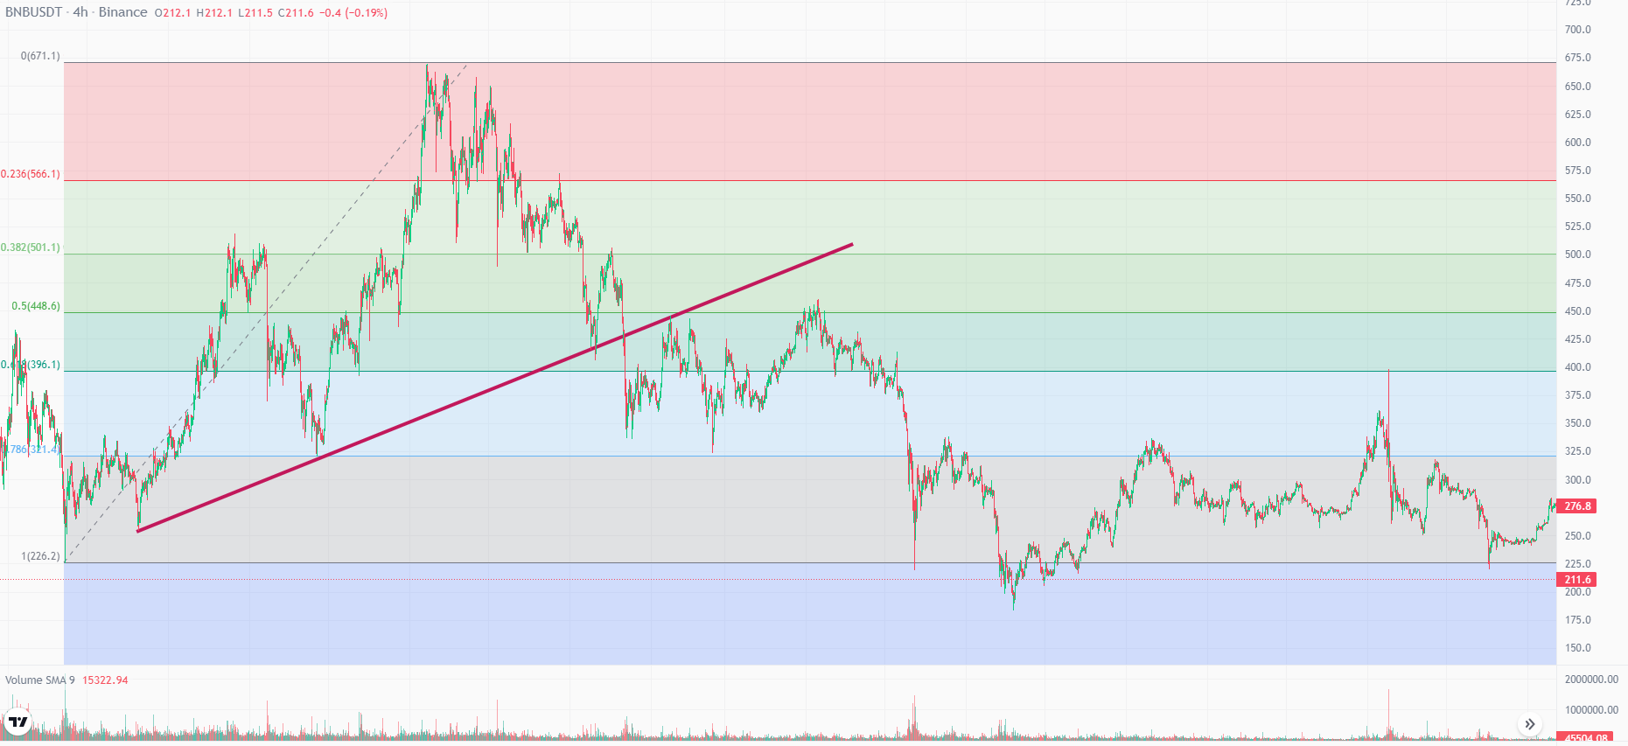
Fibonacci Retracement
Significance:
Market usually respects fibonacci numbers.
Act as possible support and resistance lines.

Slide 21
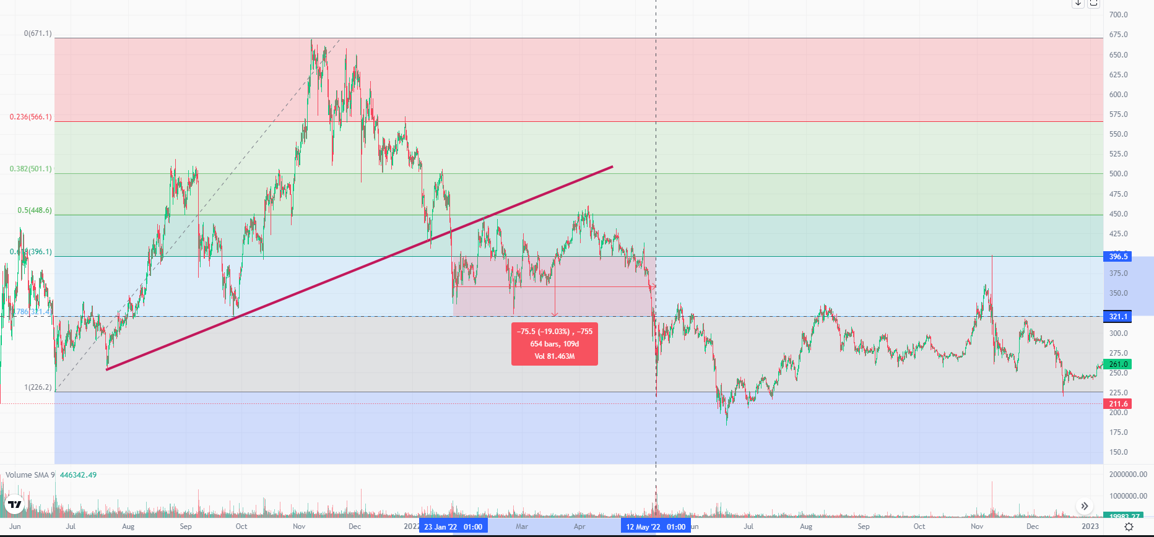
Fibonacci Retracement
Market on downtrend tests minimum of 0.38 fibonacci, the second support it may find is 0.618.
From 0.618 — 0. 786 acts as strong support zone but it goes below that then it can get into a continuous trend in the next support zone.

Slide 22
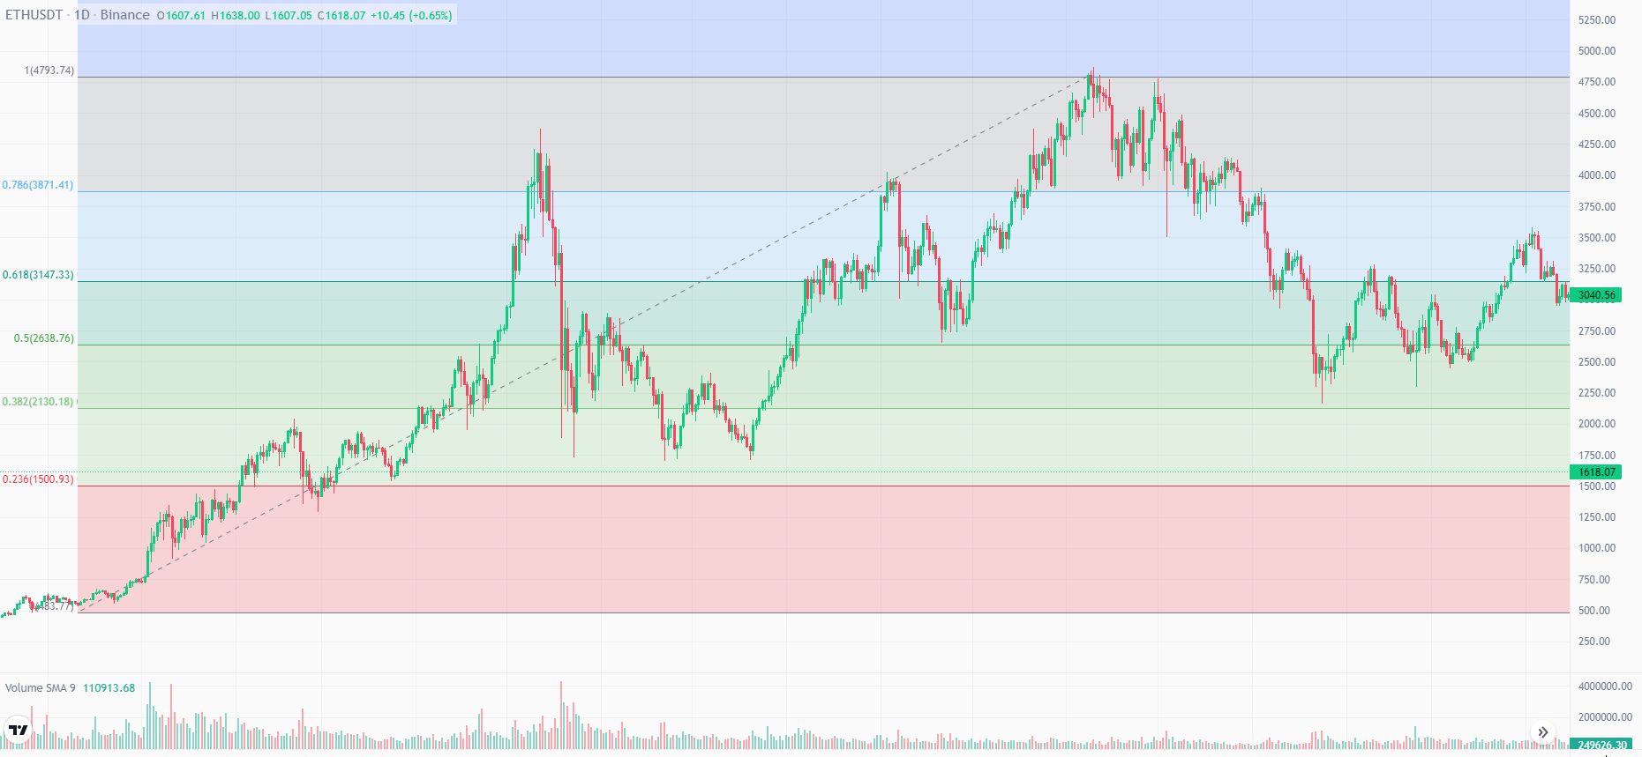
Fibonacci Retracement

